Slide 1
Diyala University
College of Engineering
Department of Civil Engineering
Water Resources Engineering
for 4th Class
By
Dr. Saad Shauket Sammen

Slide 2
Hydrology
The word hydrology means science of water which deals with the spatial and temporal characteristics of the earth’s water. Also, hydrology can be defined as the science dealing with the earth’s water in all aspects such as occurrence, distribution, and circulation on and below the earth surface and in the atmosphere.
Engineering hydrology deals with all hydrology aspects which are related to planning, design, and operation of water resources projects for the control and use of the available water. Therefore, the main purpose of the hydrological studies is to estimate the magnitude of the peak flood discharge in order to determine the reservoir capacity, spillway discharge and design of hydraulic structures.
The hydrologic cycle Except for the deep ground water, the total water supply of earth is in constant circulation from earth to atmosphere, and back to earth. The earth’s circulatory system is known as the hydrologic cycle. Hydrologic cycle is the process of transfer of moisture from the atmosphere to the earth in the form of precipitation, conveyance of the precipitated water by streams and rivers to oceans and lakes, and evaporation of water back to the atmosphere..

Slide 3
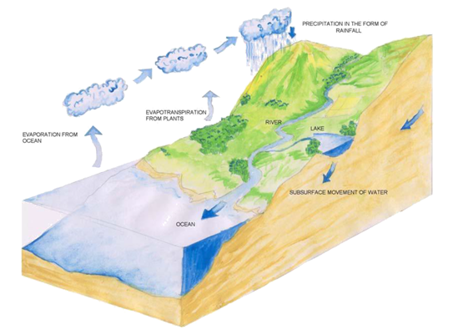
Figure 1.1 present the general form of the hydrological cycle while figure 1.2 describes the hydrological cycle in details. Hydrologic Cycle describes the continuous movement of water on, above, and below the surface of the Earth.
Figure 1.1 present the general form of the hydrological cycle

Slide 4
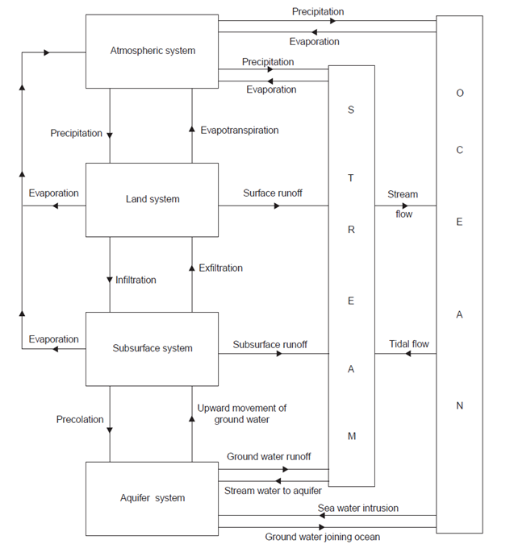
Figure 2 describes the hydrological cycle in details.

Slide 5
Elements of hydrological cycle
The hydrologic cycle consists of the following elements or processes:
1-Precipitation (P)
Precipitation could be defined as the fall of moisture from the atmosphere to the earth surface in any form. Precipitation may be in two forms:
i) Liquid precipitation as rainfall,
ii) Frozen precipitation as snow, hail, sleet, and freezing rain.
1.1 Measurement of Precipitation
One of the most crucial components of the global hydrologic cycle is the precipitation that is the basic data required to estimate any hydrologic quantity (such as runoff, flood discharge etc.). Therefore, measurement of precipitation is an important component of all hydrologic studies. Weather and water-balance studies too require information on precipitation.
Precipitation depth in unit time is called precipitation intensity.
The curve showing the variation of precipitation intensity with time is called hyetograph and is usually drawn in steps. (Fig. 1.4).

Slide 6
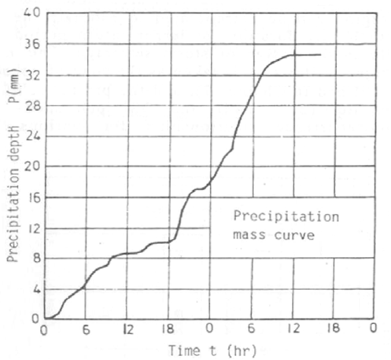
1.2 Analysis of Precipitation Records
A recording gauge provides a record of the precipitation depth as a function of time. Precipitation depth – time curve is called the mass curve. (Fig. 3)
Figure 3 Precipitation Mass Curve

Slide 7
Precipitation depth in unit time is called precipitation intensity.
The curve showing the variation of precipitation intensity with time is called hyetograph and is usually drawn in steps. (Fig. 4). The time interval Δt is chosen with respect to the size of the region and usually in the range 1-6 hours. Precipitation with intensity less than 2.5 mm/hr is called light precipitation, 2.5-7.5 mm/hr as medium, and more than 7.5 mm/hr as heavy rain. Usually average intensity reduces as the duration increases.

Slide 8
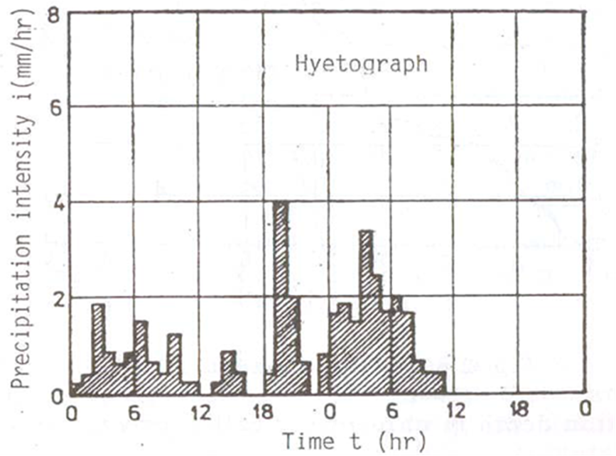
Fig. 4 Hyetograph of rainfall

